Slide 1
Projects In Express
Redis Overview

Slide 2
What Is Redis?
Open source, in memory data structure store, used as a database, cache and message broker
NoSQL Key/Value Store

Slide 3
Data Types in Redis
The data types Redis offers is one of it’s best features
Strings
Hashes
Lists
Sets
Sorted Sets
Bitmaps
Hyperlogs
Geospatial Indexes

Slide 4
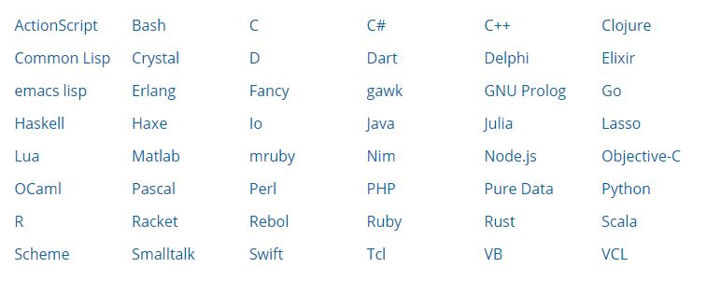
Redis Clients
Redis can be used with just about any language

Slide 5
Key/Value Pair Commands
SET – Sets a string variable
GET – Gets a value of a variable
DEL – Deletes a variable
EXISTS – Check to see if exists
INCR – Increments by 1
INCRBY – Increments by specified amount
DECR – Decrease by 1
DECRBY – Decrease by specified amount

Slide 6
Lists
Lists or groups of strings
Sorted by insert
LPUSH / RPUSH – Insert element from right or left
LRANGE – Return specific elements from list
LLEN – Return the length of the list
LPOP – Remove and return first element RPOP – Remove and return the last element

Slide 7
Sets
Unordered collection of strings
Can add, remove and test for existence
SADD – Add given values to set
SREM – Remove values
SISMEMBER – Test for given value
SMEMBERS – Return list of all elements
SCARD – Returns count

Slide 8
Sorted Sets
Like sets except elements are sorted by a “score”
ZADD – Adds a given value to set
ZREM – Removes values
ZRANGE – Fetches values in a range
ZRANGEBYSCORE – Fetch values by score

Slide 9
Hashes
Maps between string fields and string values
Represent objects
HSET – Set field in hash
HGET – Get field from hash
HMSET – Get multiple fields
HLEN – Get number of fields
HVALS – Return all fields

Slide 10


